Slide 1

Toxic comment classification
Project 5 Group 2
Fei Zheng shengjie sun zeyu yang xiaoxi zhao

Slide 2
Overview
Project Goal
Exploratory Data Analysis
Model
Improvement
Next steps

Slide 3
Project Goal
Kaggle Link: https://www.kaggle.com/c/jigsaw-unintended-bias-in-toxicity-classification
Project Goal: Identify toxic comments in online conversations, where toxicity is defined as anything rude, disrespectful or otherwise likely to make someone leave a discussion.
Toxic: “haha you guys are a bunch of losers”, “ur a sh*tty comment.”

Slide 4
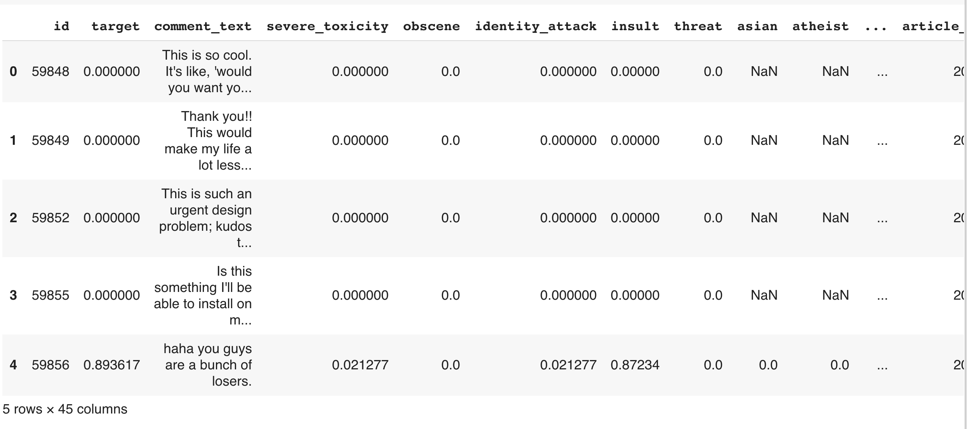
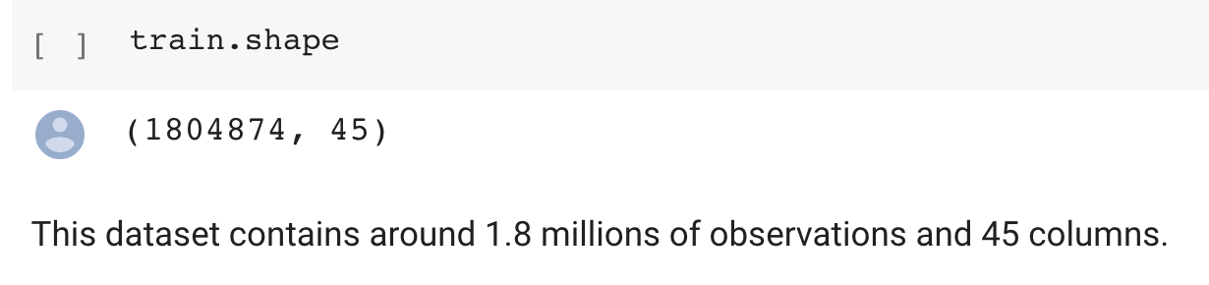
Data Overview

Slide 5
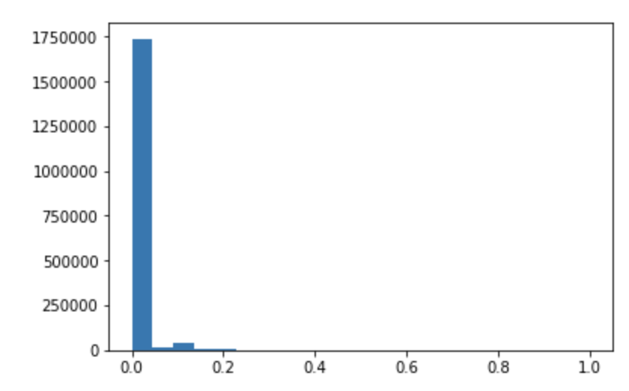
Proportion of toxic observations
This data is quite imbalanced. The majority of the observations are non-toxic. In fact, 94% of the data is not toxic.

Slide 6
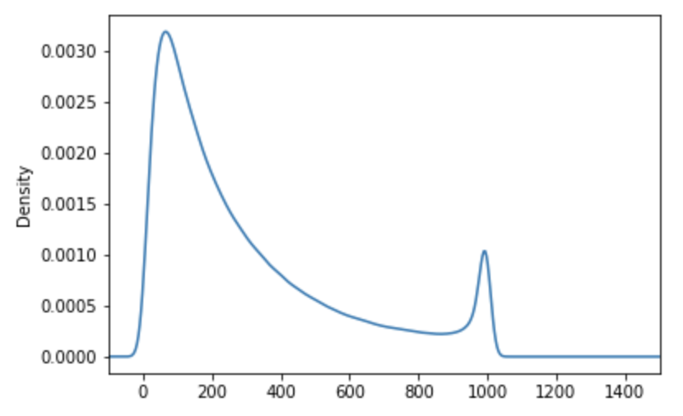
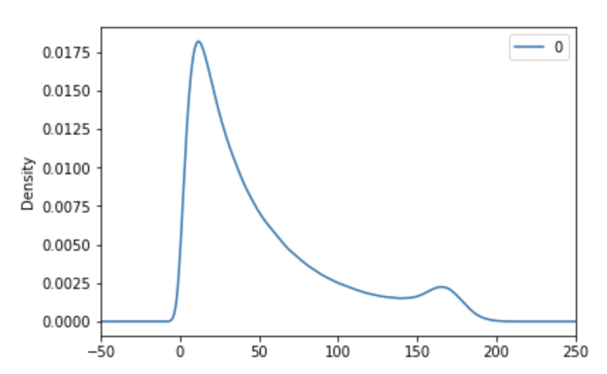
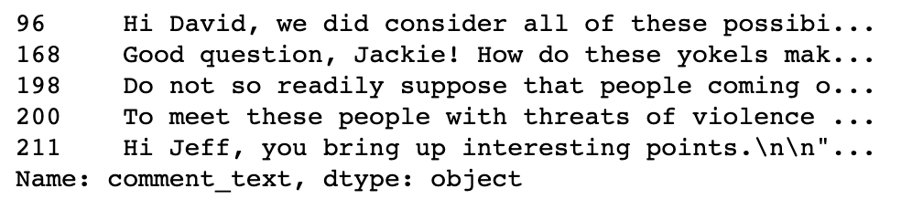
Number of characters in sentence
Number of words in sentence

Slide 7
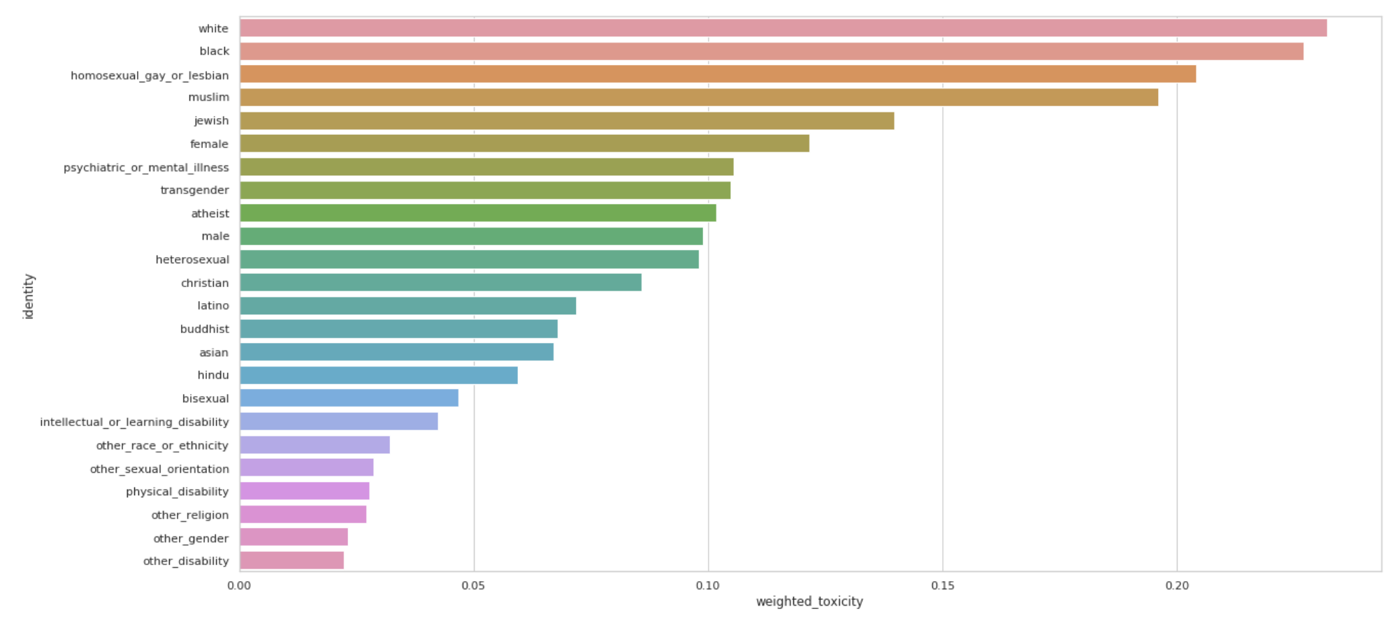
Percentage of toxic comments among different identity groups

Slide 8
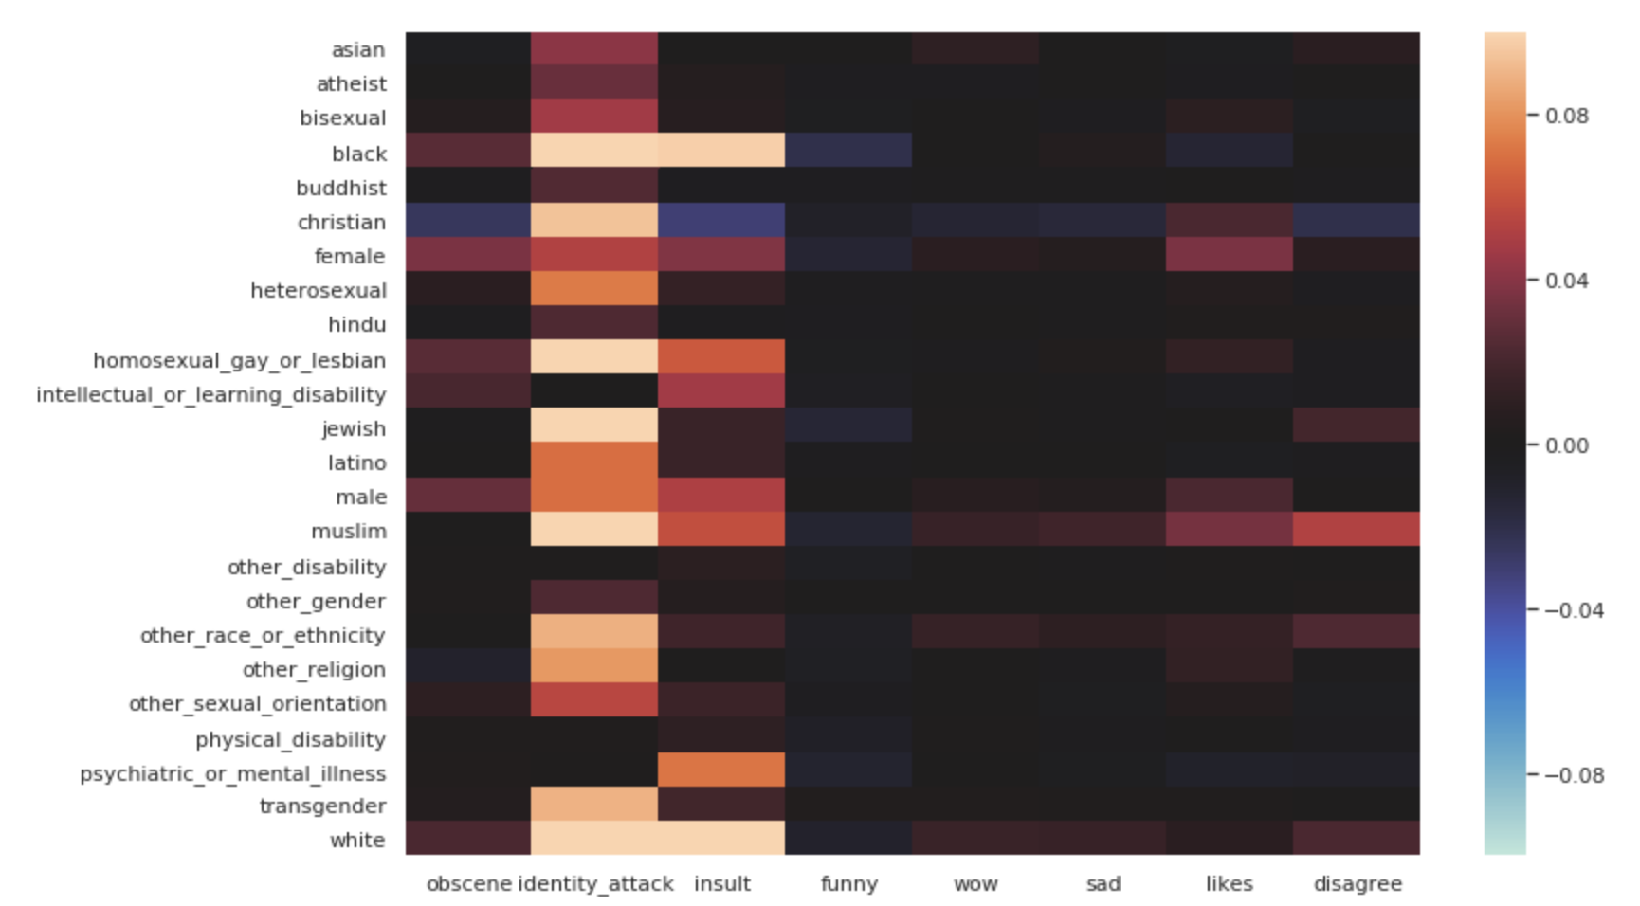
Correlation between comment labels and identity groups

Slide 9
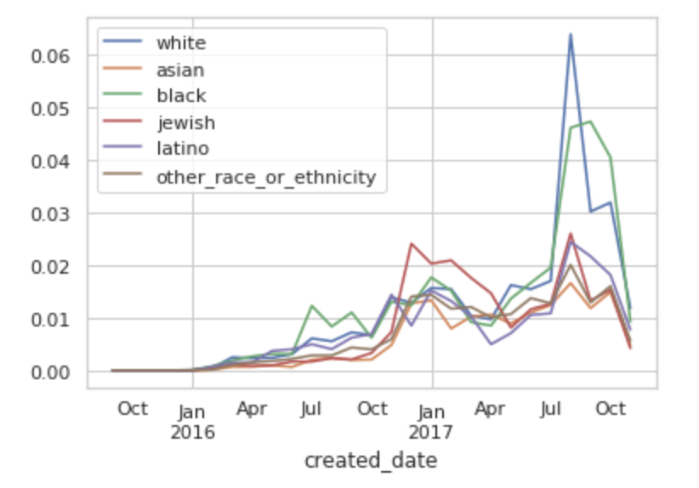
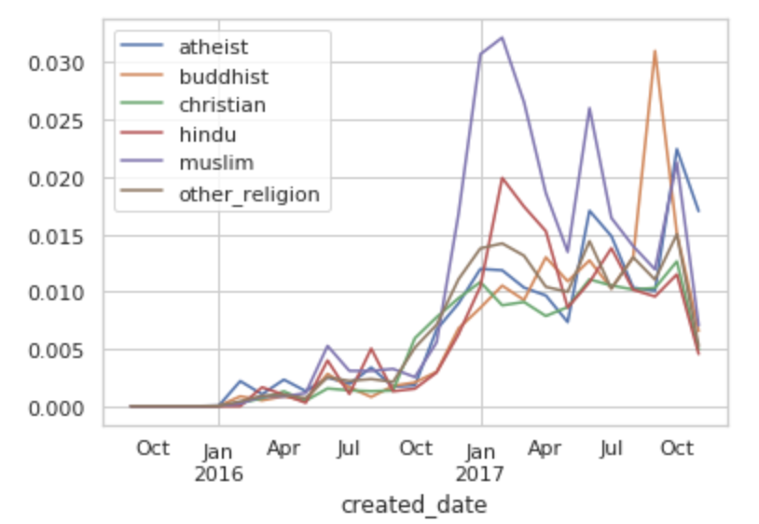
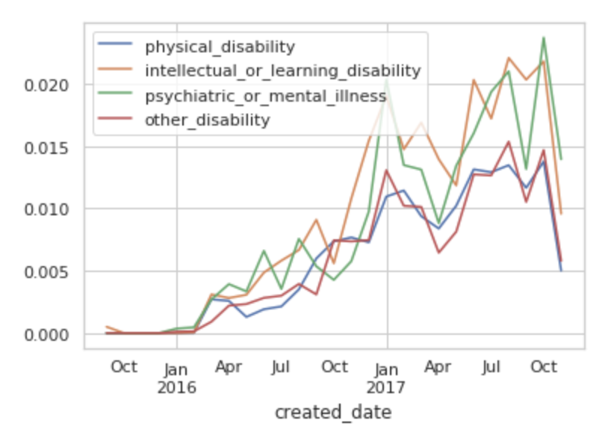
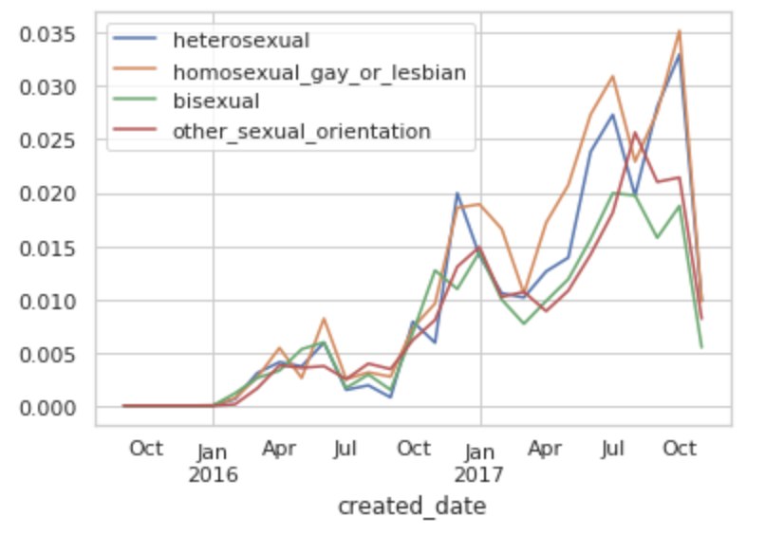
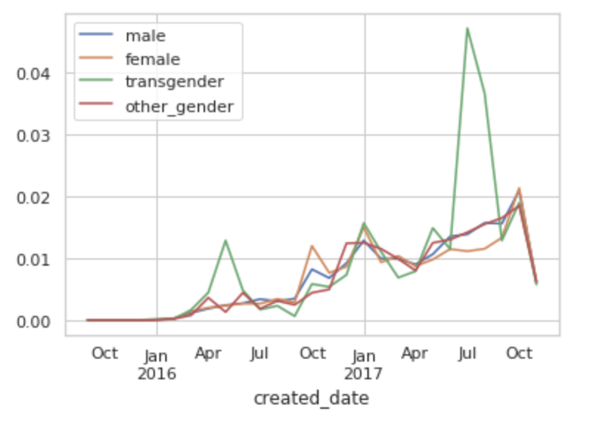

Slide 10
Model: Baseline
Recurrent Neural Network
Word Embedding
LSTM
Dropout
Auxiliary Target

Slide 11
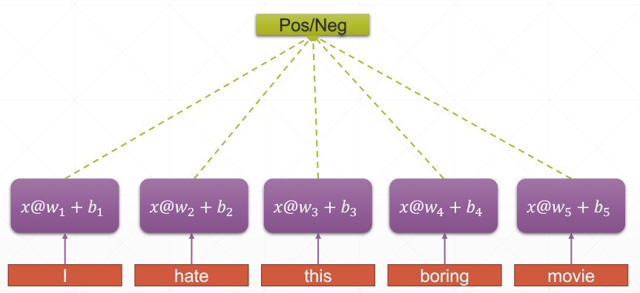
Word Embedding and RNN

Slide 12
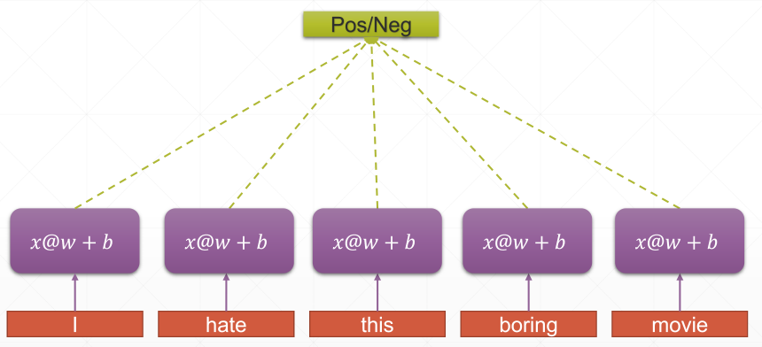
Word Embedding and RNN

Slide 13
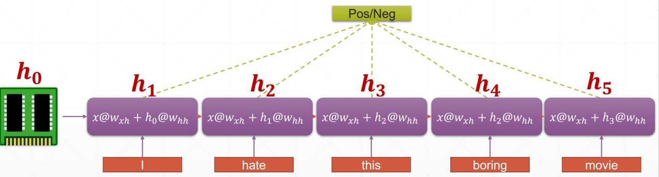
Word Embedding and RNN

Slide 14
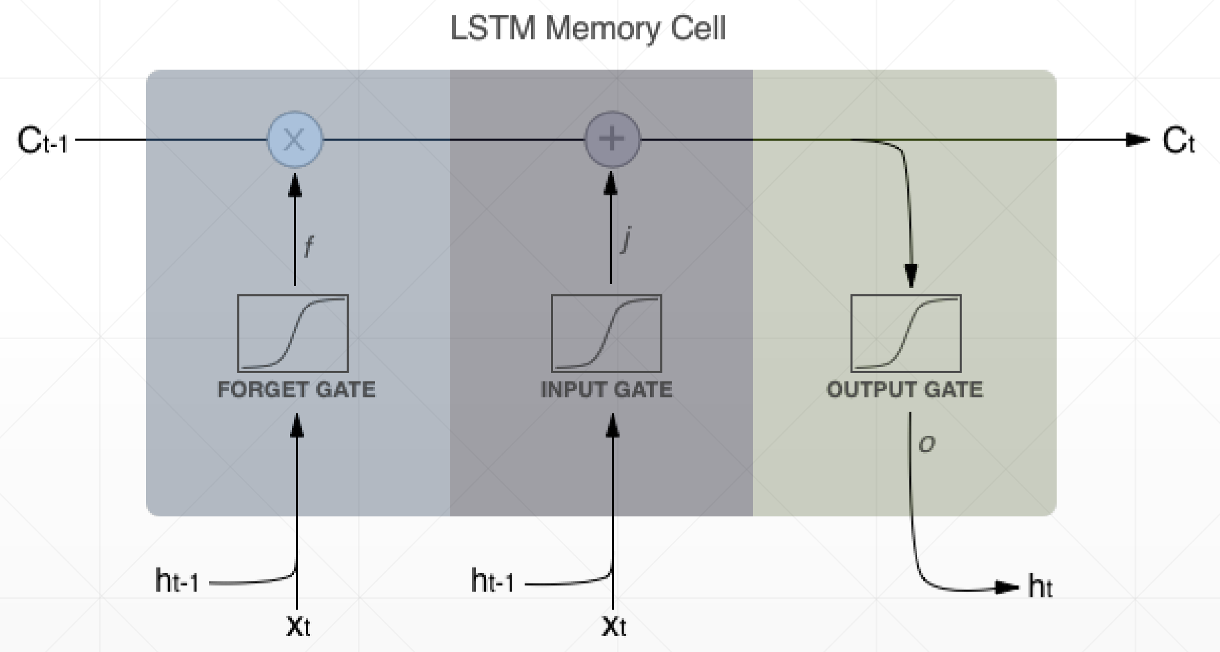
Long Short Term Memory

Slide 15
Dropout and Auxiliary Target

Slide 16
Improvement
Data Preprocessing:
1. Correct the contraction
2. Correct the error words
Model Structure:
1. Sequence Bucketing
2. Attention(Haven’t down yet)
Training Target:
1. Put weight on observations
2. Change the loss function

Slide 17
Correction
Contraction: “isn’t”: “is not”, "I'd": "I would”, "there's": "there is" , "can't": "cannot”
Use upper case, lower case, opposite case and word stem to identify a unknown word
Edit a word by deleting a character, swapping 2 characters, replacing one character and inserting a character
Perform this edit twice to get candidate words
Reduced the unknown words from 174,141 to 81,028

Slide 18
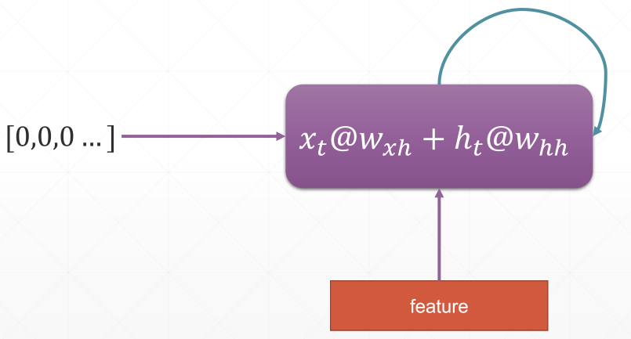
Bucketing

Slide 19
Training Target
A subset of comments have been labelled with a variety of identity attributes, representing the identities that are mentioned in the comment.
Identities are like: ‘male', 'female', 'christian', 'jewish','muslim', 'black’.
Overall AUC
Bias AUCs
Final Metric

Slide 20
VS Baseline model
 | Baseline Model | Improved Model (with bucketing) | Improved Model (without bucketing)
Score | 0.93150 | 0.93365 | 0.93375
Running Time | 5291.7 | 4457.7 | 5564.1

Slide 21
Next Steps
Try weighted average of embeddings
Try cyclic learning rate
Try attention models and transformer

Slide 22
Thank you !

